Slide 1


MUSIC STORE DATA ANALYSIS
Presented by Shukla , Shabnam

Slide 2
Introduction
In the ever-evolving landscape of the music industry, data plays a pivotal role in shaping strategies, driving decisions, and understanding consumer behavior. The "Music Store Data Analysis" project harnesses the power of SQL (Structured Query Language) to explore and extract meaningful insights from a comprehensive dataset obtained from a fictional music store.

Slide 3

Objective
The primary objective of this project is to utilize SQL queries to delve into various aspects of the music store’s operations and customer interactions. By analyzing this data, we aim to uncover patterns, trends, and correlations that can inform business strategies and operational decisions.

Slide 4
Methodology
Data Exploration:
Understanding the structure of the dataset, identifying relationships between tables, and gaining insights into the underlying data model.
Query Development:
Formulating SQL queries to retrieve specific information such as sales trends, top-selling products, customer preferences by genre, and seasonal variations in sales.
Data Aggregation and Analysis:
Using aggregate functions, statistical measures, and grouping techniques to derive meaningful metrics and performance indicators.

Slide 5

Question Set 1 - Easy
1. Who is the senior most employee based on job title?
2. Which countries have the most Invoices?
3. What are top 3 values of total invoice?
4. Which city has the best customers? We would like to throw a promotional Music Festival in the city we made the most money. Write a query that returns one city that has the highest sum of invoice totals. Return both the city name & sum of all invoice totals
5. Who is the best customer? The customer who has spent the most money will be declared the best customer. Write a query that returns the person who has spent the most money

Slide 6
Question Set 2 – Moderate
1. Write query to return the email, first name, last name, & Genre of all Rock Music listeners. Return your list ordered alphabetically by email starting with A
2. Let's invite the artists who have written the most rock music in our dataset. Write a query that returns the Artist name and total track count of the top 10 rock bands
3. Return all the track names that have a song length longer than the average song length. Return the Name and Milliseconds for each track. Order by the song length with the longest songs listed first

Slide 7
Question Set 3 – Advance
1. Find how much amount spent by each customer on artists? Write a query to return customer name, artist name and total spent
2. We want to find out the most popular music Genre for each country. We determine the most popular genre as the genre with the highest amount of purchases. Write a query that returns each country along with the top Genre. For countries where the maximum number of purchases is shared return all Genres
3. Write a query that determines the customer that has spent the most on music for each country. Write a query that returns the country along with the top customer and how much they spent. For countries where the top amount spent is shared, provide all customers who spent this amoun

Slide 8
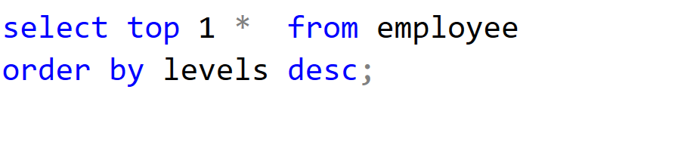
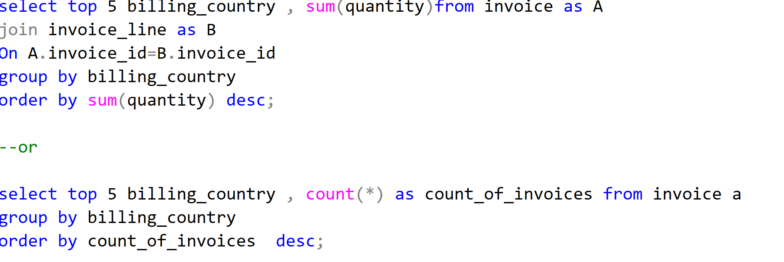

Question Set 1 - Easy
1. Who is the senior most employee based on job title?
2. Which countries have the most Invoices

Slide 9
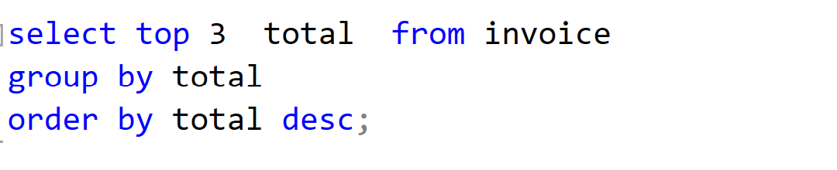
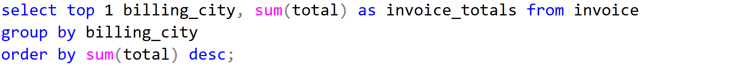
3. What are top 3 values of total invoice?
4. Which city has the best customers? We would like to throw a promotional Music Festival in the city we made the most money. Write a query that returns one city that has the highest sum of invoice totals. Return both the city name & sum of all invoice totals

Slide 10
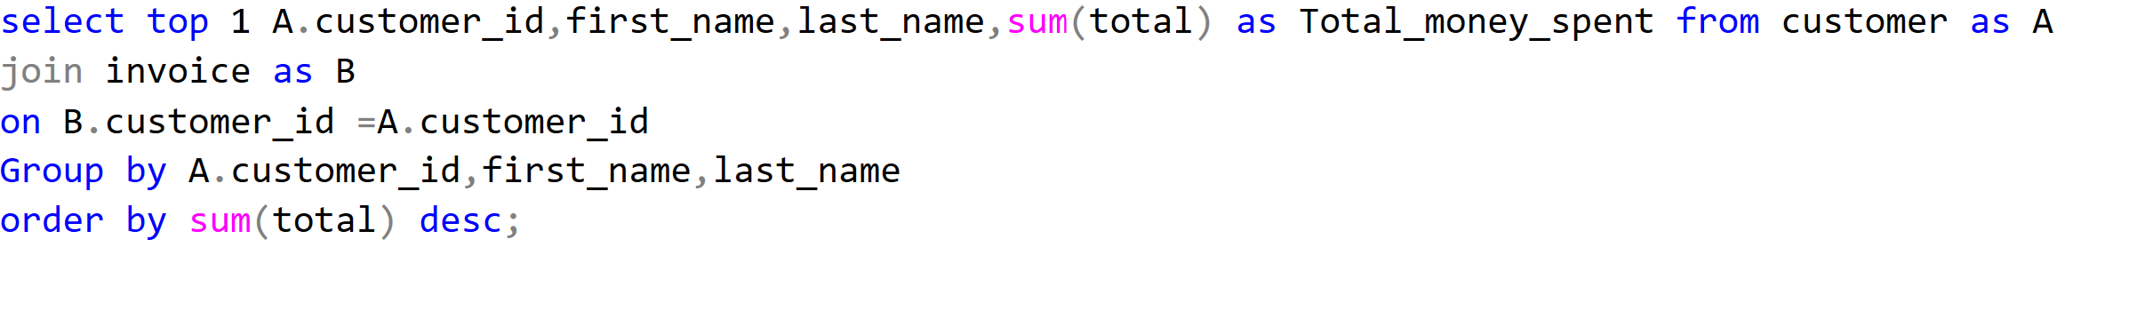
5. Who is the best customer? The customer who has spent the most money will be declared the best customer. Write a query that returns the person who has spent the most money

Slide 11
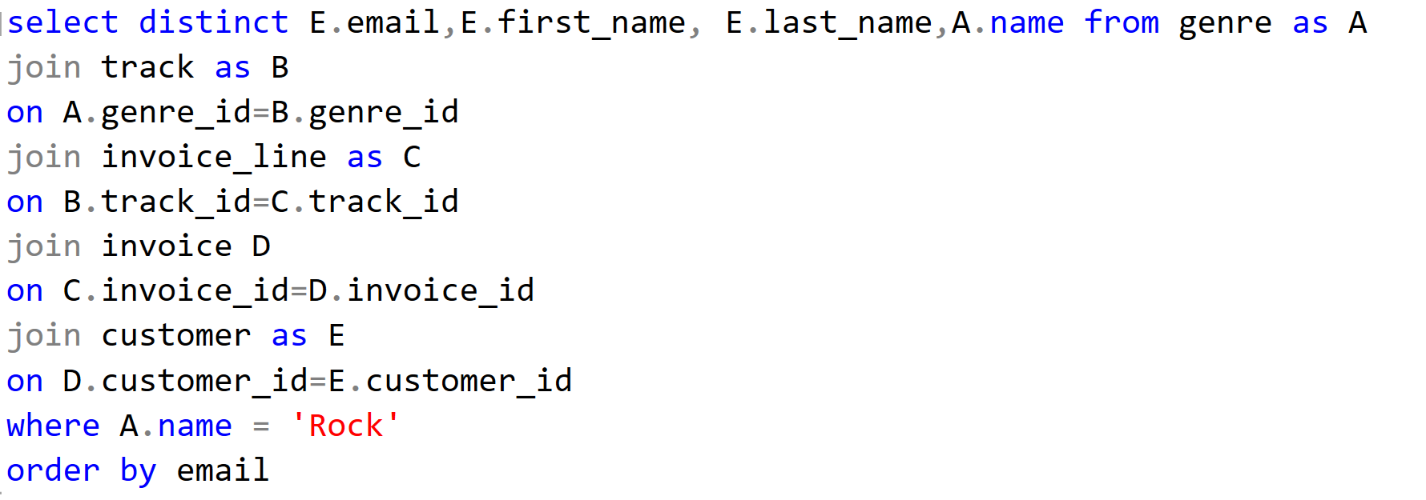
Question Set 2 – Moderate
1. Write query to return the email, first name, last name, & Genre of all Rock Music listeners. Return your list ordered alphabetically by email starting with A

Slide 12
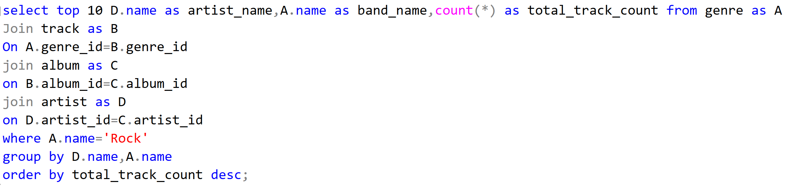
2. Let's invite the artists who have written the most rock music in our dataset. Write a query that returns the Artist name and total track count of the top 10 rock bands

Slide 13
3. Return all the track names that have a song length longer than the average song length. Return the Name and Milliseconds for each track. Order by the song length with the longest songs listed first

Slide 14
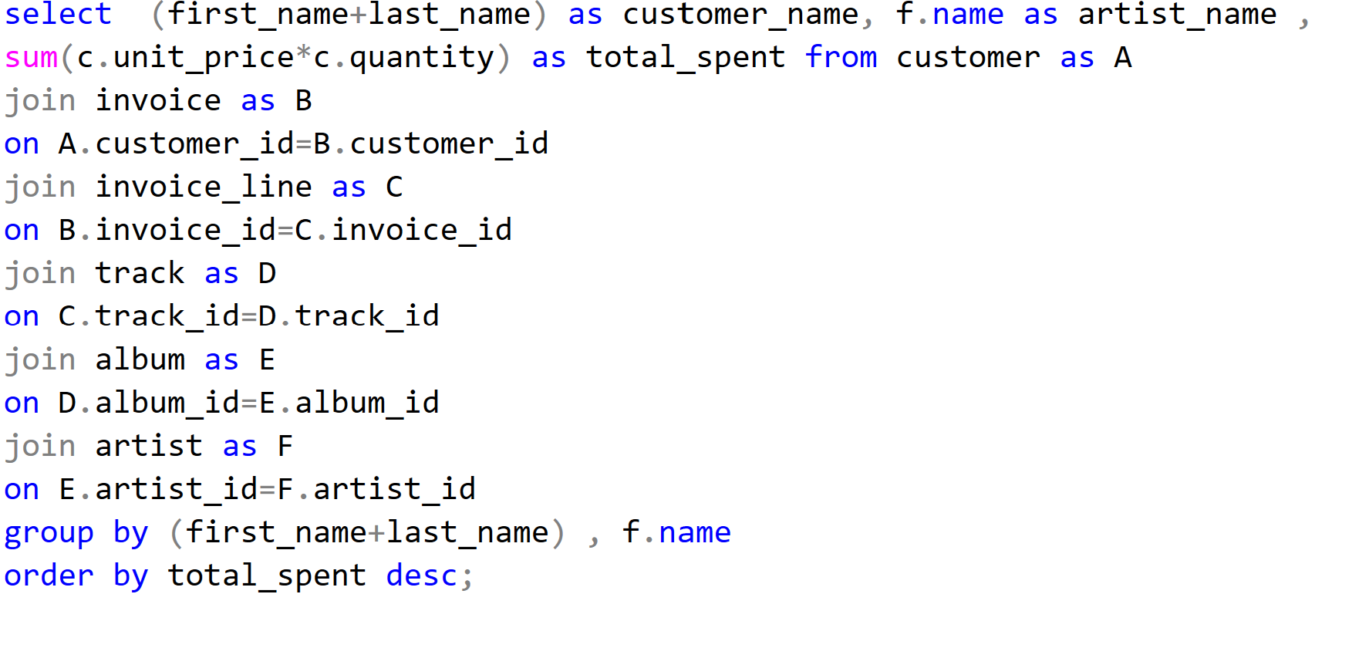
Question Set 3 – Advance
1. Find how much amount spent by each customer on artists? Write a query to return customer name, artist name and total spent

Slide 15
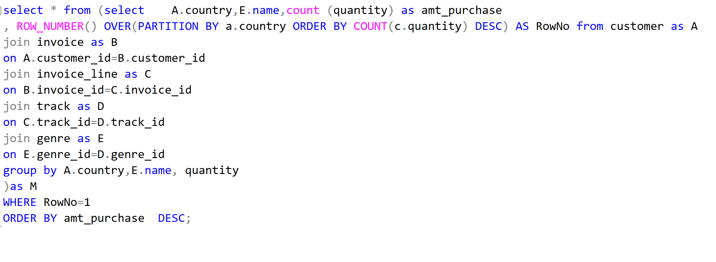
2. We want to find out the most popular music Genre for each country. We determine the most popular genre as the genre with the highest amount of purchases. Write a query that returns each country along with the top Genre. For countries where the maximum number of purchases is shared return all Genres

Slide 16
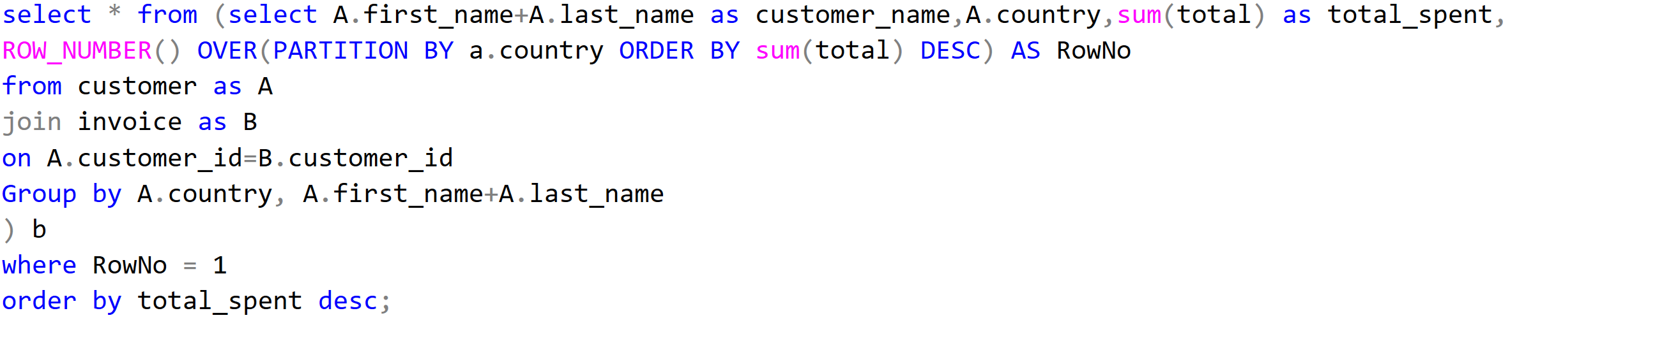
3. Write a query that determines the customer that has spent the most on music for each country. Write a query that returns the country along with the top customer and how much they spent. For countries where the top amount spent is shared, provide all customers who spent this amount

Slide 17
Insights
Employee Seniority: Identified the most senior employee based on job title, offering insights into organizational hierarchy and leadership roles.
Invoice Analysis:
Top Countries by Invoices: Highlighted countries with the highest number of transactions, guiding localized marketing and inventory strategies.
Top Invoice Values: Identified top invoice values, indicating high-value transactions and potential premium product preferences.
Customer and City Analysis:
Best Customer: Identified top-spending customer, crucial for targeted marketing and loyalty programs.
Best City for Customers: Determined the city with the highest invoice totals, guiding decisions on promotional events and customer engagement strategies.
Genre and Music Insights:
Rock Music Listeners: Identified customers who prefer Rock music, aiding in targeted marketing campaigns and inventory management.
Top Rock Bands: Recognized popular Rock bands based on track counts, valuable for promotional partnerships and customer engagement.
Advanced Insights:
Customer Spending on Artists: Revealed customer spending patterns on specific artists, guiding personalized marketing and partnership strategies.
Popular Genres by Country: Identified popular music genres per country, informing localized music recommendations and event planning.
Top Customer Spending per Country: Identified top-spending customers per country, crucial for personalized customer service and loyalty programs.

Slide 18
Recommendations
Targeted Marketing Campaigns:
Leverage insights on top genres and customer preferences (e.g., Rock music listeners) to tailor marketing campaigns. Focus on personalized promotions and recommendations to enhance customer engagement and increase sales.
Artist and Music Partnerships:
Geographical Expansion Strategies:
Build partnerships with popular artists and bands (identified through track counts and genre preferences) to attract their fanbase and drive music sales. Collaborate on exclusive releases, promotions, or live events to enhance brand visibility and customer loyalty.
Expand market reach and capitalize on high-performing regions (identified through top invoice totals) by exploring new store locations or strengthening online presence. Tailor offerings to local preferences and enhance customer acquisition in these regions.

Slide 19

Presented by Shukla , Shabnam

